Slide 1
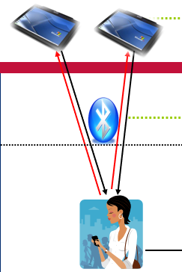
Data Transfer
Data Transfer: Interviewer (sender) >> Bluetooth >> Supervisor (receiver) >> CSWeb >> Central Office

Slide 2
What? Why? When? Who? How?
What?
Why?
When?
Who?
How?
Submitting data to the supervisor
Constantly backup data, check on progress
At least once per day (the more the better!)
Supervisors, Interviewers
Bluetooth

Slide 3
Fieldwork Flow
Arrive in cluster, Identify households
Interviewers carry out women interviews, enter biomarker data
Supervisor assigns households to interviewers
Interviewers send data to supervisor
Interviewers interview HHs, identify eligible individuals
Team resolves structural problems
Supervisor submits data to central office
Lab scientists collect blood for malaria/anemia

Slide 4

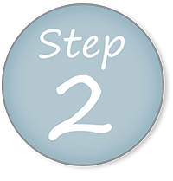
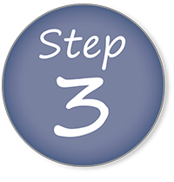
Steps in Data Transfer/Submitting
Supervisor prepares to receive data from one interviewer at a time
Interviewer sends data to supervisor
Supervisor reviews structural messages and progress report

Slide 5


Key points to remember
Only one interviewer at a time can send data to supervisor
Bluetooth is not wifi – those connecting should be < 10 meters apart
Supervisor must be in receive mode before interviewer begins sending
Sender and receiver must co-ordinate so that they both begin the transfer process at about the same time
Supervisor tablet will generate report of questionnaires begun or completed by interviewer
Co-ordination between team members is essential !

Slide 6
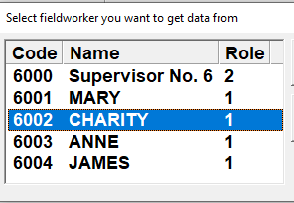
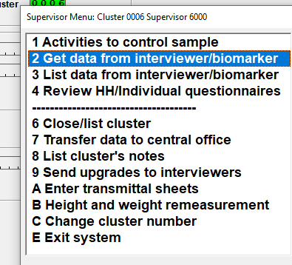
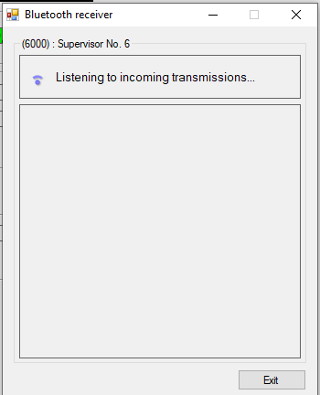
Supervisor prepares to receive data
Supervisor ready! Tell interviewer to send…
Notes:
Supervisor is ready! Interviewers can watch! More eyes on each selection, the better

Slide 7
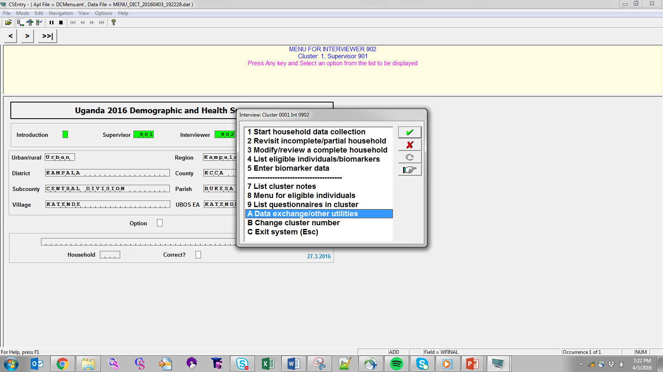
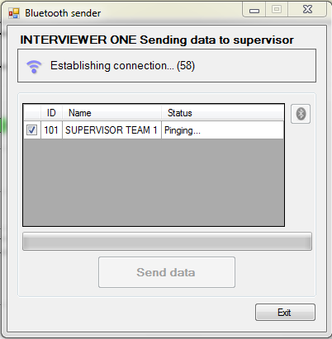
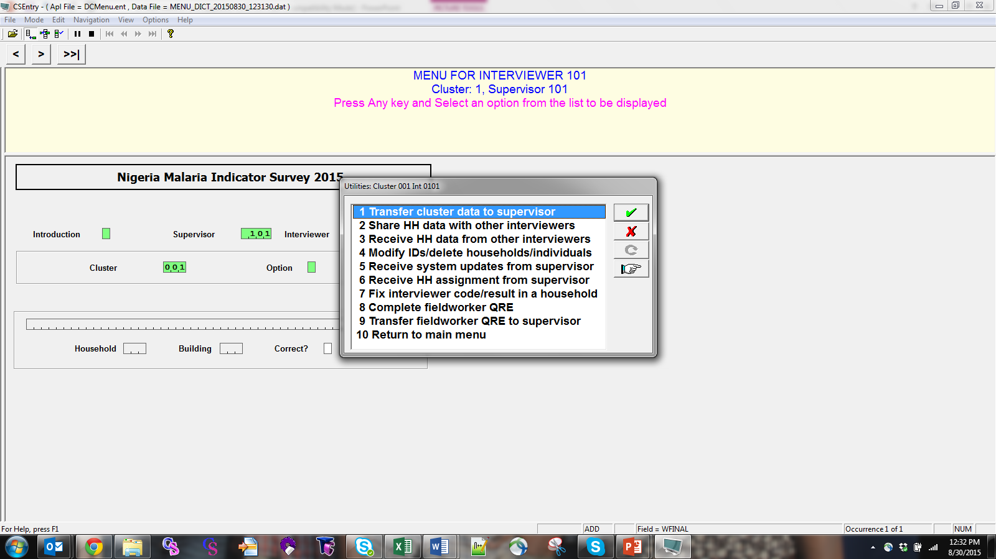
Interviewers send data
Once green, click Send data
If red, connection failed…
now what??
Notes:
If failed, ASK trainees to tell you what to do if Bluetooth fails… in supervisor manual
1. Check entered supervisor, interviewer, cluster correct in menu 2. try again 3. check Bluetooth is turned on

Slide 8
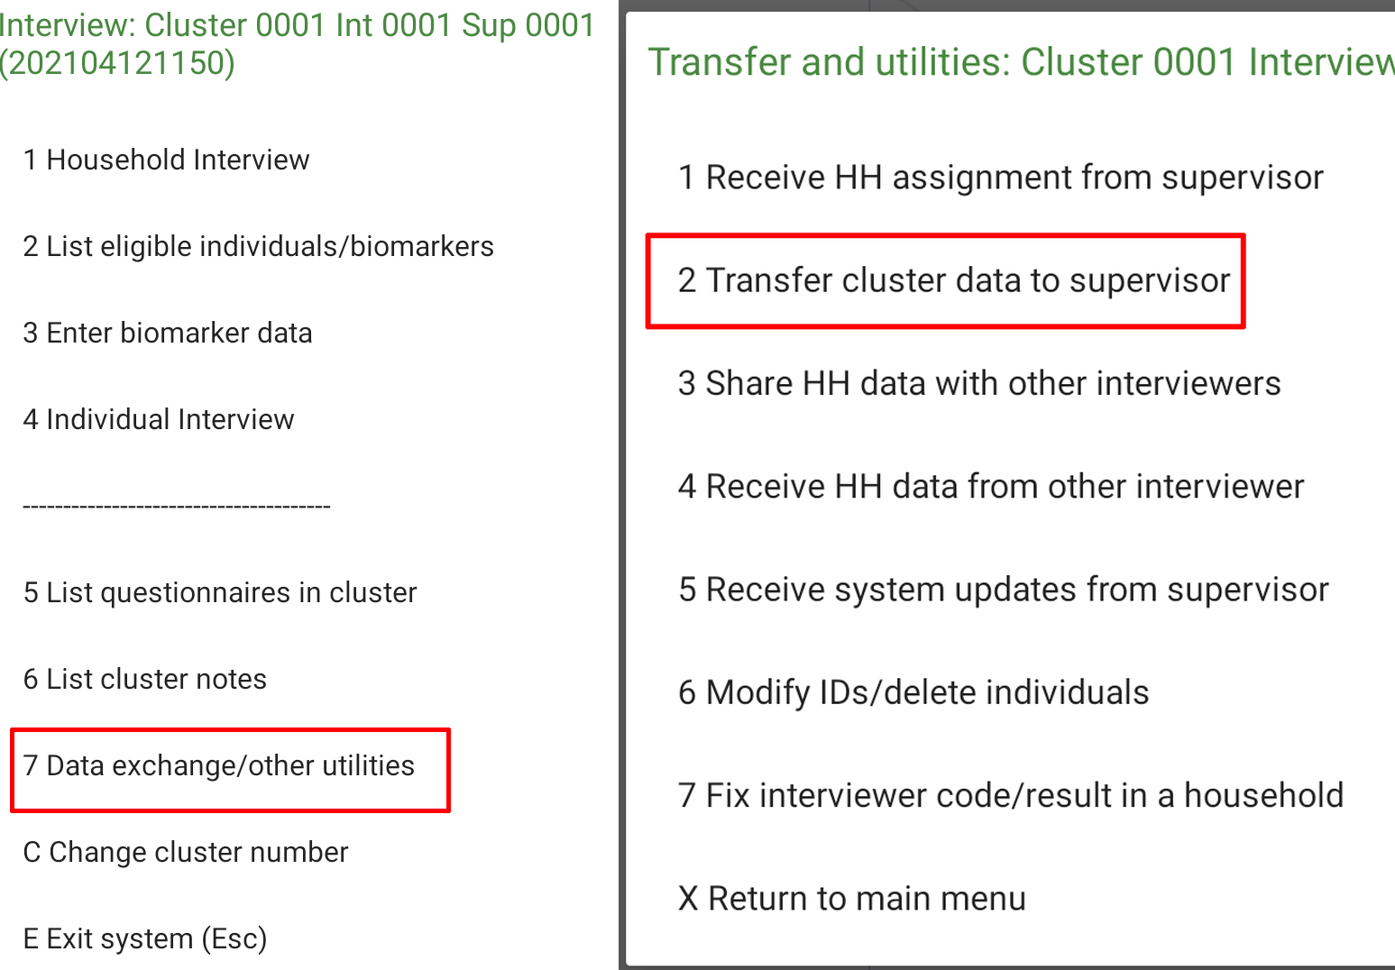
Interviewers send data
Notes:
If failed, ASK trainees to tell you what to do if Bluetooth fails… in supervisor manual
1. Check entered supervisor, interviewer, cluster correct in menu 2. try again 3. check Bluetooth is turned on

Slide 9
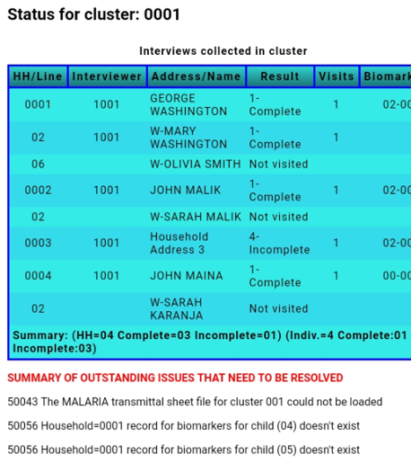
Check structure and progress
If data transfer successful, supervisor will see a listing of the questionnaires done by that interviewer:
Team should attempt to resolve issues regularly, rather than leaving until the very end… more on that later!
Notes:
For now, this is just evidence that the transfer worked! We will work on resolving problems later….
Listing checks to see that what was supposed to be done was done, and what shouldn’t be done, hasn’t been done
Point out components of listing – cluster, interviewer number, result code, number of visits, biomarker done/not done, total numbers at bottom

Slide 10
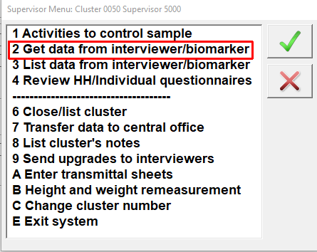
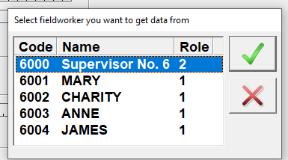
Supervisor to supervisor transfer
Supervisor must receive data from themselves!
From supervisor menu, supervisor chooses themselves as interviewer
Same listing as interviewers appears with messages for supervisor’s households…
Notes:
Interviewers can watch! More eyes on each selection, the better

Slide 11
Data Transfer
DEMONSTRATION VIDEO
Notes:
Note: when starting the video, move to the 6.00 minute mark to move to the section on data transfer from interviewer to supervisor

Slide 12

Avoiding problems with Bluetooth transfers – Rules to follow
Receiver must always wait until sender is ready
Put in receive mode just before sender sends
Work together as a team
Never put machine in receive mode before sender is ready to send

Slide 13
Troubleshooting: If Bluetooth transfer fails
Try transfer again
If still fails, check Bluetooth settings and switch Bluetooth device off and on for both tablets
Try again
If still fails, shut down both tablets and try again
If still fails, check Bluetooth settings to verify no devices are paired and unpair if necessary
If still fails, contact IT support

Slide 14
Inconsistent result codes: Problem
Example
Supervisor assigns households 1 and 2 to an interviewer and sends via Bluetooth
Interviewer completes interviews for households 1 and 2 but doesn’t send interviews to supervisor yet
Then… supervisor assigns household 3 to interviewer and sends assignment file via Bluetooth to interviewer
The interview status of “completed” on the interviewer tablet for households 1 and 2 will be set to “Not visited” because the assignment file on the supervisor tablet has not been updated from the interviewer tablet

Slide 15
Inconsistent result codes: Solution
Golden rule to avoid problems:
Before supervisor sends new assignment to an interviewer they should always receive the latest interview data from that interviewer
Doing so ensures that the assignment file they send has result codes consistent with the data on the interviewers tablet
Always transfer data in following order:
1. Interviewer sends data to supervisor
2. Supervisor sends any new assignments to interviewer via Bluetooth

Slide 16
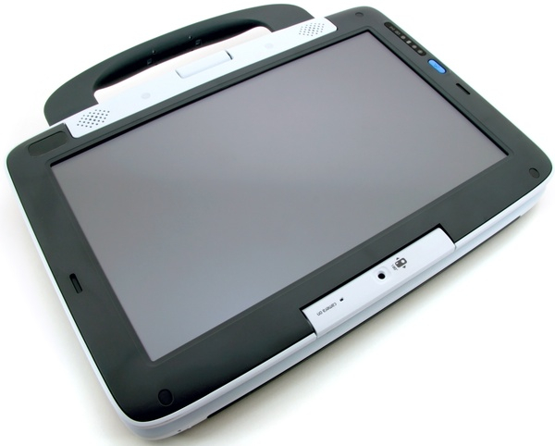
Avoiding problems with inconsistent result codes
DO THIS FIRST
THEN THIS
Interviewer (sender)
Interviewer (sender)
Bluetooth transfer of interview data
Bluetooth transfer of assignment data
Supervisor (receiver)
Supervisor (receiver)

Slide 17

Exercise
Each interviewer (one at a time) should send their data to their supervisor.
When the data is received, review the report. Does it correctly show the status of the work done by the interviewer to date ?

Slide 18
Data Transfer
EXERCISE FEEDBACK AND QUESTIONS

